Slide 1
CS622 Final Exam Review

Slide 2
Final Exam Parameters
You have 3 hours to complete the exam, which is proctored online with Examity.
Notes: Notes are allowed for the exam, whether they be on physical paper or digital notes.
No Textbook or Internet Resources allowed.
Software: Word processing software (such as Word, WordPerfect, and the like) and integrated development environment (IDE) software (such as Eclipse, IntelliJ, and the like) are permitted.
Scratch Paper: Use of 5 pieces of blank scratch paper is allowed.
Special Instruction: Students working from a laptop computer are allowed to use an external monitor to replace the use of the laptop screen. If the student chooses to use an external monitor, the laptop screen must not be visible to them during the exam.

Slide 3
General Proctoring Requirements
ü Alone in room – if someone might enter the room like a child or roommate please let your proctor know this beforehand. They will most likely ask you to pan the room to make sure the person is no longer in the room.
ü Clear Desk and work area – this includes any written material regardless if it’s for class or not. If the exam allows printed materials student will show those to the proctor and will be allowed to keep them on their desk.
ü Computer connected to a power source
ü No phones or headphones – please keep your cell phone or home phone in the same room. If the proctor is not able to reach you they will call your phone.
ü No dual monitors – if you have dual monitors you will need to unplug one of them and move it away from your workspace.
ü No leaving your seat – if you have to use the restroom or adjust anything in the room please let your proctor know. The proctor will make a note of it and may ask you to pan the room with your webcam.
ü No talking
ü Webcam, speakers, and microphone must remain on throughout the test – this is so the proctor can see you and also contact you if need be.
ü The proctor must be able to see you for the duration of the test – If a proctor asks you to adjust your webcam please know they are trying to make sure the exam is appropriately monitored so they may periodically remind you to adjust your webcam.

Slide 4
Final Exam Structure
The final exam consists of 5 essay questions each worth 20 points.
Each question is focused around a significant topic found in weeks 1 through 5.
You can move forward or backward between questions, and revisit questions.
You will expand your term project to support new requirements in each question.
It’s a good idea to have a full class diagram of your project, as well as the code of your project accessible.

Slide 5
Final Exam Scenario
You explore different aspects of this scenario for every question:
Imagine that the application you developed for your term project in the weekly assignments is in-use in the real world. Further imagine that thousands of users are using your application. As a result, two requirements become clear.
Requirement 1: Users must have some way to configure different options supported by the application.
Requirement 2: Users must be able to save a particular configuration long-term and reload it again many days later; they may save many different configurations.
You need to think about how you would expand your project to support these requirements. For each of the problems, you will provide key code samples and explanations for the following facets of the implementation -- abstract classes and interfaces, exception handling, generics, object reading and writing, and concurrency.

Slide 6
Question Evaluation
Your facilitator will evaluate each question with a more detailed rubric specific to each question.
You will see the rubric in the question instructions.
Your facilitator will grade each question with the same rigor as the project, and they will leave you a one or two sentence summary of their review that you will see when the final is released.

Slide 7
Study Strategies
Know your project well.
Review the main concepts from textbook, online lectures, and projects. The final exam is designed to cover the most significant topics from the first 5 weeks.
The questions are designed to assess your comprehension of the material or the ability to apply the material to specific problems. This is in contrast to knowledge recall questions which ask you only to recall a piece of information.
The way we as human beings are wired, we learn better incrementally rather than in long blocks. The earlier you can begin studying, the more material you are likely to retain and understand. Also, breaking study periods into 15-20 minutes blocks with breaks in-between can help you retain information better.

Slide 8
Whirlwind Review Starting with Week 1 Highlights

Slide 9
What is Programming?
Programming is the art and the science of writing instructions for computers and devices to execute.
You provide a set of instructions in a strictly defined language; these instructions are translated into machine code that the computer can understand.
Learning to program simple tasks is fairly easy; mastering programming requires many skills, a good amount of experience, and a lot of understanding.

Slide 10
The Need for Applications
An application is a piece of software on a computer or device that allows you to perform a specific set of tasks.
Applications have an interface which supports your interaction, logic which makes the tasks work, and storage which stores important durable information for the long-term.
As a programmer, you are typically coding an application.

Slide 11
Information Systems
Today, many applications are one component in larger information systems.
With an information system, people, data, processes, and information technology interact to collect, process, and store the information needed to support an organization. (Whitten, 2007)

Slide 12
What is a Class?
A class is the blueprint from which individual objects are created.
A class defines the names, datatypes, visibility, and other properties of all attributes and methods.
Attributes represent and object’s data, and methods represent an object’s behavior.

Slide 13
What is an Object?
An object is an instance or occurrence of a class.
An object has its own values for the attributes.
Typically an object’s behavior is the same as all other objects’ for the same class.

Slide 14
Polymorphism
public class Car {
private int milesDriven;
public Car(int miles) {
this.milesDriven = miles;
}
public int findPrice() {
if (milesDriven < 50000) return 20000;
else return 10000;
}
}
public class ElectricCar extends Car {
private int energyEfficiency;
public ElectricCar(int miles, int eff) {
super(miles);
energyEfficiency = eff;
}
public int findPrice() {
int temp = super.findPrice();
if (energyEfficiency < 3) return temp + 20000;
else return temp + 25000;
}
}
public class Main {
public static void main(String[] args) {
Car c = new Car(48000);
System.out.println(c.findPrice());
ElectricCar ec = new ElectricCar(4000, 5);
System.out.println(ec.findPrice());
}
}
Output
20000
45000111.

Slide 15
Constructors and Inheritance
Classes with no constructor automatically have an implied constructor that calls super() and does nothing else.
If the parent class does not have a no-argument constructor, child classes cannot rely on this default constructor.
If a class defines any constructor, the default constructor is not applied to the class.

Slide 16
Downcasting
Student g = new GradStudent();
g.setTitle("My Thesis"); // doesn't compile
System.out.println("Thesis title = " + g.getTitle()); // doesn’t compile
// Explicit downcast (if you are in a code block where it’s already determined it’s a grad student)
((GradStudent)g).setTitle("My Thesis");
// Explicit downcast combined with an instanceof check (where it may not be a grad student instance)
if (g instanceof GradStudent)
((GradStudent)g).setTitle("My Thesis");
Notes:
With downcasting, the type is declared as the parent type, and then to access child methods the object can be cast down to one of the child classes.

Slide 17
Abstract Classes
An abstract class cannot be instantiated, but its non-abstract child classes can.
Abstract classes can contain defined methods, or can contain abstract methods which must be implemented by any non-abstract child classes.
Abstract classes are useful when you want to leave some behavior undefined and require that child classes define it.

Slide 18
Interfaces
An interface can contain constants, method declarations, and optionally default method implementations.
Any class that implements the interface must define all methods that do not have a default defined.
A class can implement multiple interfaces, thereby simulating multiple inheritance.
Abstract classes are more structured and can have state; interfaces can contain methods but no state.

Slide 19
Comparable Interface
public class DriversLicense implements Comparable<DriversLicense> {
private String firstName;
private String lastName;
private int licenseID;
public DriversLicense(String first, String last, int licenseID) {
this.firstName = first; this.lastName = last; this.licenseID = licenseID;
}
public int compareTo(DriversLicense otherLicense) {
int retVal;
if (licenseID == otherLicense.licenseID) retVal = 0;
else if (licenseID < otherLicense.licenseID) retVal = -1;
else retVal = 1;
return retVal;
}
}
public class Main {
public static void main(String[] args) {
DriversLicense SallysLicense = new DriversLicense("Sally", "Small", 5);
DriversLicense BobsLicense = new DriversLicense("Bob", "Glass", 2);
DriversLicense ElainasLicense = new DriversLicense("Elaina", "Afilia", 5);
DriversLicense VishnusLicense = new DriversLicense("Vishnu", "Santhana", 10);
System.out.println("Sally's license compared to Bob's license: " + SallysLicense.compareTo(BobsLicense));
System.out.println("Sally's license compared to Elaina's license: " + SallysLicense.compareTo(ElainasLicense));
System.out.println("Sally's license compared to Vishnu's license: " + SallysLicense.compareTo(VishnusLicense));
}
}
Output
Sally's license compared to Bob's license: 1
Sally's license compared to Elaina's license: 0
Sally's license compared to Vishnu's license: -1
Notes:
Notice that the comparable interface returns a negative number, 0, or a positive number depending upon how it compares.
The Collections framework in Java relies on this interface for several operations.

Slide 20
Week 2 Highlights

Slide 21
Durable Storage
Many applications have the need to store some data indefinitely.
There are two common approaches – databases and files.
If an application uses a database, it will have a portion of its code devoted to persistence – translating to and from the database model.
Likewise, if an application uses a file, it will have a portion of its code devoted to translating to and from the file contents.

Slide 22
Text File
At a high level, a file is either categorized as a text file or a binary file.
A text file stores a series of text characters using a character encoding, such as ASCII, UTF-8, or UTF-16 (the default in Java is UTF-8).
Text files are generally simpler than binary files, are universally readable, and error-tolerant.
On the other hand, text files are generally only useful for character data, and not other kinds of data.

Slide 23
Text Formats
Note that “text file” is a very broad term encompassing any file consisting solely of characters.
There are many more specific types within the category.
XML
HTML
SQL
Python
Java
Etc …

Slide 24
Writing to Text Files
Formatter Class
A sequential-access text file can be created with the Formatter object.
BufferedWriter Class
BufferedWriter can write text and binary data.
Formatter creates a named file if the file doesn’t already exist.
Formatter allows you to carefully control what you write with formatting expressions.

Slide 25
Reading From Text Files
Scanner Class
Scanner allows you to read in data from text files with specific methods supporting different datatypes, to read in datatypes as a whole.
BufferedReader Class
BufferedReader allows you to read in any data (not just strings) from files.
You need to cast to make the contents a string.
Files.readAllLines() Method
The readAllLines method reads in the entire file into a list.
Useful if the text file isn’t excessively large.

Slide 26
Regular Expressions
A regular expression is a text string that supports special characters and syntax that describes a search pattern.
A “*” character for example means “match anything”.
Regular expressions are useful for string searching and manipulation, as well as file searching and manipulation.

Slide 27
Some Regular Expression Methods
The String.matches() method allows you to search the string for the specified pattern.
The String.replaceAll() method creates a new string with all matches to regular expression replaced with the specified string.
The String.split() method allows you split a string into an array based upon the regular expression search string.

Slide 28
Exception Terminology
The terms Exception and Error are closely related in programming, but carry different implications.
Both terms are used to describe an event that disrupts the normal flow of instruction in an application.
Exception implies that the language has built-in syntax for wrapping errors and separate code paths for handling them.
Error does not carry such an implication, and only suggests that a problem has occurred in the application.
Notes:
Divide by zero
File not found
Invalid input
Etc …

Slide 29
Exception Advantages
The detection of the error is separated by syntax from the handling of the error.
Detection of the error usually happens in a called method (same as it would with traditional error checking).
Handling of the error happens in a special block just for exceptions (not available with traditional error checking).
Methods can be labeled with the exceptions they throw.
If a language supports it, callers of methods that throw exceptions can be forced to handle the exception.

Slide 30
Exception Components
throw
Methods use the “throw” keyword to throw the exception when an error is encountered.
try ... catch
Exceptions are caught for any code within the try block.
Code to handle the exception is put into the catch block.
throws
A method can declare what exceptions it throws with the “throws” keyword.
finally
Code in finally block is always executed whether or not the exception is caught, rethrown, or not.

Slide 31
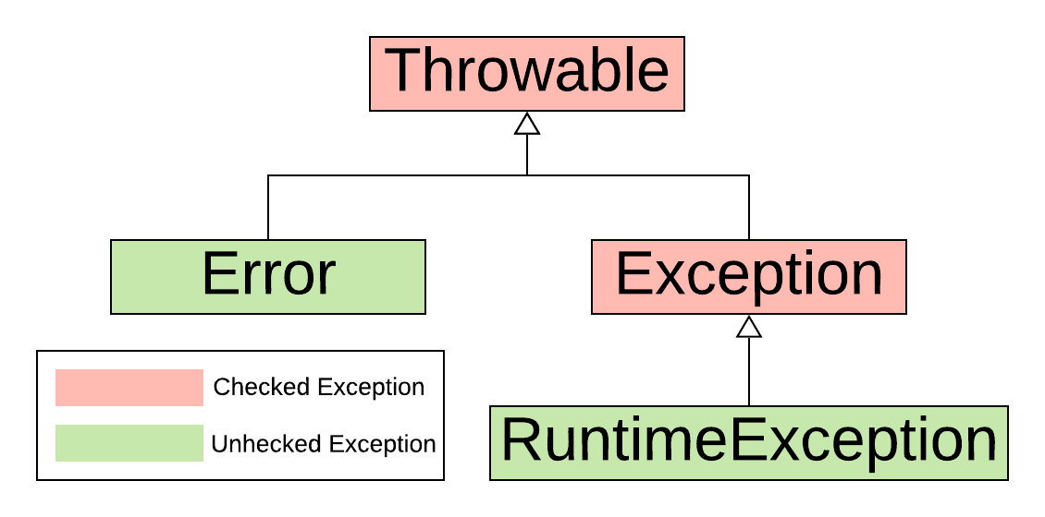
Checked/Unchecked Hierarchy
Notes:
Checked exceptions force the caller to either handle the exception or to propagate the exception to the next caller (unchecked exceptions do not).

Slide 32
Week 3 Highlights

Slide 33
Generics Overview
Without generics, multiple methods and classes would be created to do the same thing, just with different datatypes.
This is terrible. If the logic changed in one, it would need to change in all. Also, it’s confusing to the programmer to call many different methods to do the same thing.
A generic is placeholder for any object type.
One generic method or class can be written, and callers decide which datatypes they use the class or method with.

Slide 34
Example Generic Declaration and Usage
public class GenericMethods {
static Integer[] iarr = {2, 5, 8};
static Double[] darr = {28.67, 5.05, 8.3};
static String[] sarr = {"Twelve", "Angry", "Men"};
public static void main(String[] args) {
showArray(iarr);
showArray(darr);
showArray(sarr);
}
public static <T> void showArray(T[] a) {
for (T elem: a)
System.out.print(elem + " ");
System.out.println();
}
}
Output
2 5 8
28.67 5.05 8.3
Twelve Angry Men

Slide 35
Generic Bounded Type: Inheritance
By default, a generic represents any object type.
This can be constrained to a class and its subclasses by bounding the generic, for example: <T extends SomeClass>

Slide 36
Generic Wildcards
Generic wildcards let you use a generic class when you don’t know or care exactly which type it’s working with.
For example, a method could use List<?> as the datatype to represent it takes a list as a parameter, but it the generic in the list can be anything.
Wildcards can be bounded. For example, List<? extends SomeClass> means that the list can only use SomeClass or one of its subclasses in the generic.

Slide 37
Backward Compatibility
The Java compiler checks the correctness of code that uses generics at compiletime, then erases their use when generating the bytecode, to ensure backward compatibility.
A generic class is does not exist at runtime; only the base class exists. All instances of a generic class are instances of the same base class.
A generic class is does not exist at runtime, so it’s not possible to create a new instance of it.

Slide 38
When to Use Generic Summary
Use a generic when the class using the generic class or method must work with an exact datatype, yet the class or method defining the generic does not need to work with an exact datatype.
Use a generic when logically you are creating a class template or method template that works across many types (to avoid redefining it over and over again for each type).

Slide 39
Week 4 Highlights

Slide 40
Binary File Review
Any file that is not a text file is a binary file.
The contents and layout of a binary file depend upon its format and the application that supports it.
For all but the application that can decode it, a binary file is generally considered a series of unreadable bytes.
By convention only, an extension (period followed by an acronym) is put in the filename so we know what it is.
Binary files may contain some text, and often consists of specific data structures laid out on disk.

Slide 41
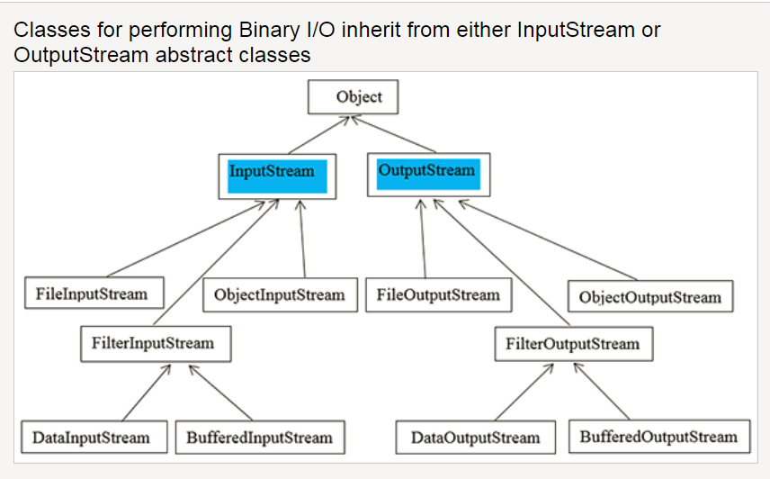
InputStream and OutputStream
Notes:
Taken from http://www.cs.sjsu.edu/faculty/pearce/modules/lectures/oop/streams/streams.htm
DataInputStream reads bytes from the stream and delivers them as corresponding primitive types or Strings.
DataOutputStream converts primitive-type values or Strings into bytes and writes the bytes to the stream.
Good for working with specific datatypes instead of reading everything in a bytes and doing manual conversions.
FileInputStream and FileOutputStream work with raw bytes and is more flexible.

Slide 42
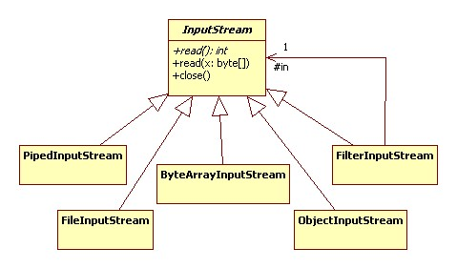
InputStream Details
Notes:
Taken from http://www.cs.sjsu.edu/faculty/pearce/modules/lectures/oop/streams/streams.htm

Slide 43
Java Serialization
Object serialization encodes an Object into a sequence of bytes.
Serialization includes the object's data, information about the object's type, and information about the types of data stored in the object.
Object deserialization decodes the sequence of bytes back into a Java object.
The process is platform independent; objects serialized on one platform can be deserialized on another platform.
The process is version dependent; an encoding from one Java version may or may not be compatible with another version.
For its objects to be serialized, a class must meet two requirements:
it implements the Serializable interface.
all of its members are serializable (are either primitive types or implement the Serializable interface), or are marked transient.
Classes ObjectInputStream and ObjectOutputStream are high-level streams that contain the methods for serializing and deserializing an object.

Slide 44
Inner Classes
With inner classes, one class is nested within another class or method.
Nested inner classes are tied to the instance of the object. The outer class must be instantiated, and then the inner class exists within the context of that object.
Method local inner classes can only be seen and used from within that method.
Static inner classes are not tied to an object. They can be instantiated independently of other objects.
Anonymous inner classes are declared and instantiated in the same statement.

Slide 45
Lambdas
Lambda calculus, researched throughout the 1900s, is well-known in computer science.
In lambda calculus, functions such as add(x, y) = x + y are represented anonymous as (x,y) -> x+y.
In Java, it uses the same syntax to represent simple functions defined on the fly.
In Java, a lambda is tied to a functional interface – an interface consisting of a single abstract method.
Thus, lambdas can be passed around as arguments just like any other object.

Slide 46
Streams
Streams provide a way to more efficiently and concisely process collections of objects.
A stream is not just another data structure; rather, it transforms Collections, Arrays or I/O channels
A stream does not modify the underlying data; rather, it provides the transformations as new results.
There are three broad types of operations – stream creation, intermediate operations, and terminal operations.

Slide 47
Streams
A stream operates lazily in that it only evaluates the entire stream when the terminal operation occurs.
Streams can be evaluated in parallel rather than one-by-one, depending upon the underlying architecture, for increased efficiency.
In addition to parallelism, streams are pipelined which means that when one operation has finished working on one part of a collection, the next operation can start working on it without waiting for the entire collection to be processed.
Streams consist of creation operations, intermediate operations, and terminal operations.

Slide 48
Week 5 Highlights

Slide 49
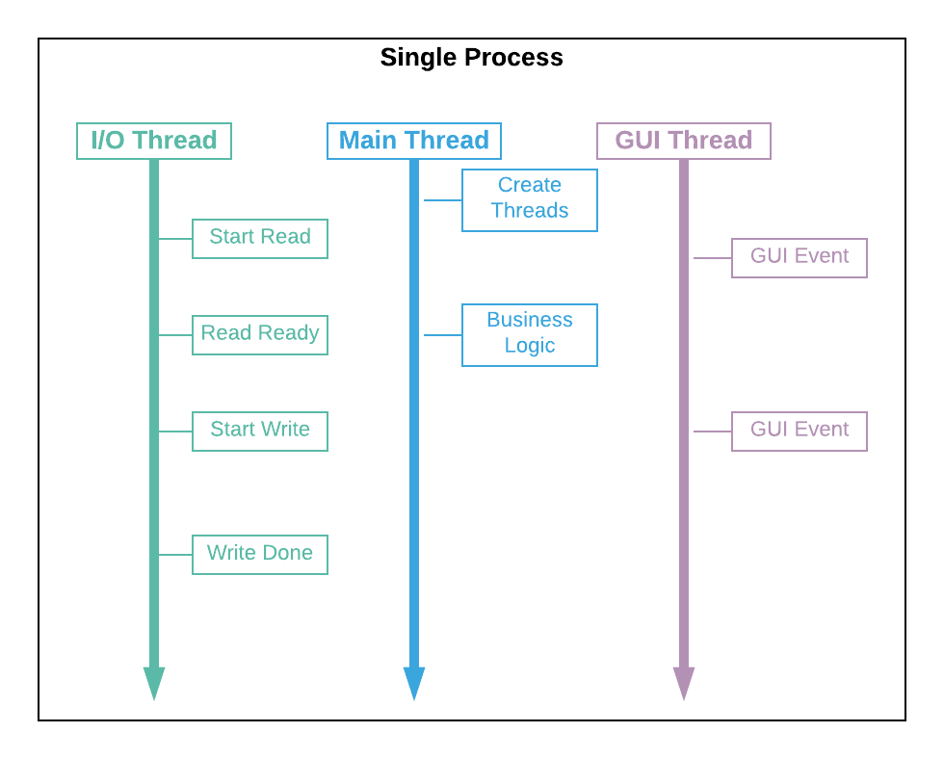
Multithreading Visual
Notes:
A thread is a lightweight execution stream within process.
Each thread shares memory, data, and code within a process, but has its own execution stream (PC counter, registers, and stack).

Slide 50
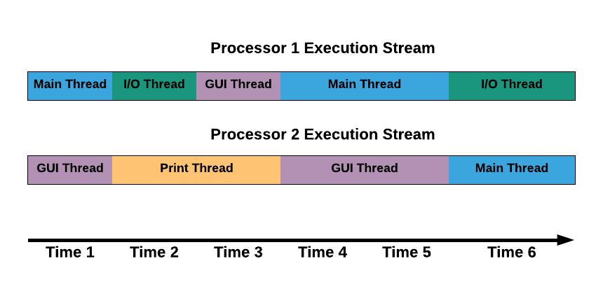
Scheduling Visual
Notes:
The scheduler keeps certain requirements to help ensure all threads execute in an orderly fashion.
However, the ordering of any particular set of threads is not guaranteed and can vary from execution to execution, device to device.
There are ways to prioritize threads and control some aspects of their execution.
It’s very important to verify thread interoperability at a conceptual level because you cannot rely on tests alone.

Slide 51
Thread Implementation in Java
Runnable Interface
Multiple ways to create
Suitable for Long-Running
Callable Interface
Can return value when done
Suitable for Shorter Tasks

Slide 52
Thread States in Java
State | Explanation
New | The thread was just created but not yet runnable.
Runnable | The thread is ready to be executed. It may or may not be currently running depending upon scheduler.
Blocked/Waiting | The thread is temporarily inactive because it’s waiting on a lock, resource, or a notification.
Timed Wait | The thread is temporarily inactive for a specific amount of time (which can be preempted).
Terminated | The thread has finished executing (successfully or unsuccessfully) and is no longer scheduled to run.

Slide 53
Basic Thread Control in Java
Operation | Explanation
Thread.start() | Creates a new thread for a new stream of execution.
Thread.join() | The current thread waits for another thread to complete (optionally within a maximum wait time).
Thread.sleep() | The current thread becomes temporarily inactive for a specified period of time.
Thread.yield() | Gives a hint to the scheduler that another thread can be executed instead of the current thread.

Slide 54
Thread Coordination Strategies
Thread Private Resource
If the resource or variable is kept private to each thread (each thread has its own copy), then the need to coordinate access is eliminated.
Threadsafe Datatype
If the datatype itself ensures synchronization, the threads do not need to coordinate access.
Thread Synchronization
When resources or variables must be shared between threads, thread synchronization ensures that only one thread accesses it at a time.
Immutable Resource
If the resource or variable is immutable, then multiple threads can read it without the need to coordinate access.
Notes:
Two major concerns with all multi-threaded applications is protecting the integrity of shared memory and resources, and ensuring correct results despite the concurrency (serializability).
Because threads run within a single process, they share memory and other resources such as files.
Accessing such resources with no coordination between the threads can result in unpredictable results and can ruin the integrity of the resources.

Slide 55
Thread Synchronization in Java
Operation | Explanation
Synchronized keyword | The current thread obtains a lock on the specified monitor object (defaulting to the “this” object) for the duration of a code block or method.
Object.wait() | The current thread releases its lock on a monitor and becomes temporarily inactive until it is notified (via the notify() or notifyAll() methods).
Object.notify() | Notifies one of the threads waiting on the object, causing the thread to enter the runnable state again (can resume execution when the monitor lock is released). Which thread is selected is arbitrary and implementation dependent.
Object.notifyAll() | Notifies all of the threads waiting on the object, causing all such threads to enter the runnable state again (can resume execution when the monitor lock is released).
Volatile keyword | The given variable will not be cached locally by a thread but will always be accessed in main memory. Further, all datatypes will be treated as atomic.

Slide 56
Deadlock Avoidance Strategies
Acquire Locks in Same Order
If the resource locks are always acquired in the same order across all threads, deadlock cannot occur.
Consign Locking to Single Thread
One design pattern has a single thread performing the tasks where locking would be required. The other threads submit requests to the locking thread for it to perform the work.
Change Coordination Strategy
Deadlock can only occur if threads are synchronized with locks (monitors or Java locks). Change to immutable resources, thread private resources, or threadsafe datatypes coordination strategy (reference “Thread Coordination Strategies” slide).
Notes:
Deadlock occurs when two or more threads are waiting on each other. Each has a resource the other wants.
This can result in application “hangs”.
This can only happen when the same monitors are locked across threads, but in different orders.

Slide 57
Executors and ExecutorService
The Executors class creates different types of threadpools for the app’s needs:
Statically sized thread pool for a fixed number of threads.
Dynamically sized thread pool that reuses threads if available, and creates new ones as needed.
Single threaded pool.
The ExecutorService subclasses act as both a threadpool and a means of creating and interacting with threads.
Notes:
Some applications need to have large amounts tasks running in parallel, such as application servers, middleware servers, aggressive clients, and the like, on the order of thousands of threads if not more.
It is not efficient to continually decomission old threads and create new threads every time a new task is needed.
A threadpool re-uses threads (streams of execution, not to be confused with the Java Thread class) to avoid this inefficiency.

Slide 58

Please fill out the class survey.

